Slide 1
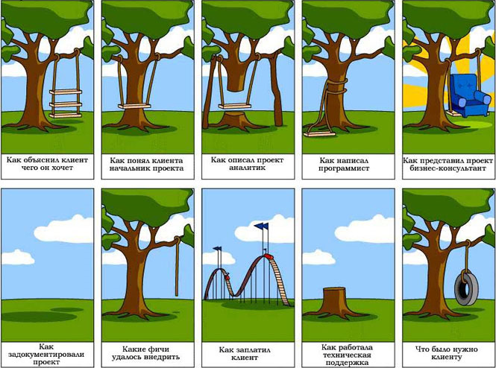
Spring Framework. Углубленный курс. Специализация
Иван Спресов
Юлий Слабко

Slide 2
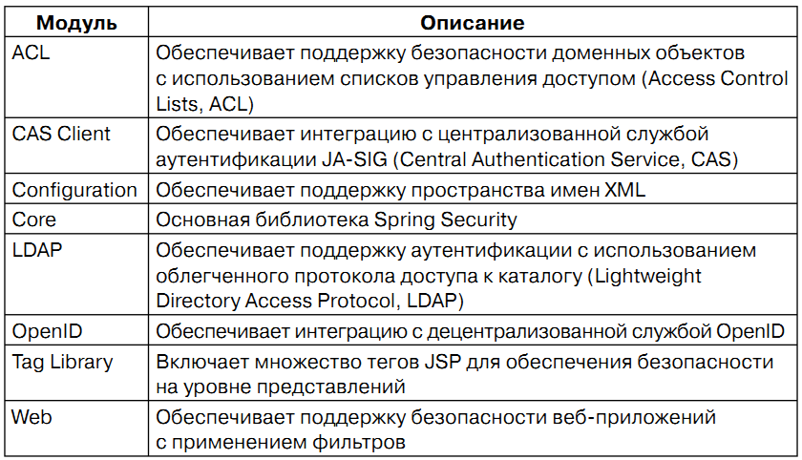
Spring Security Structure

Slide 3
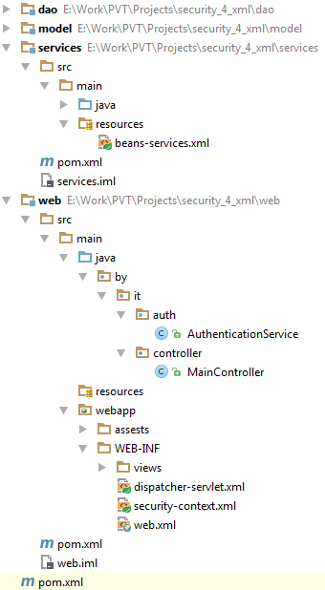
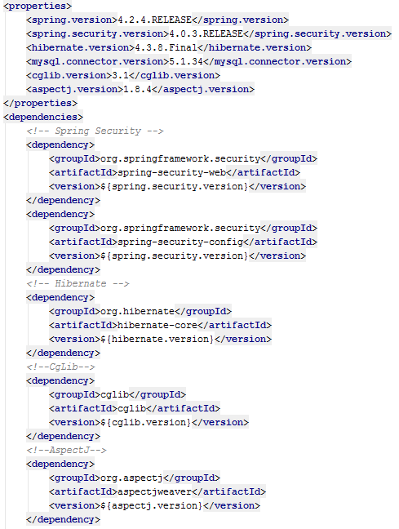
Spring Web-app Structure

Slide 4
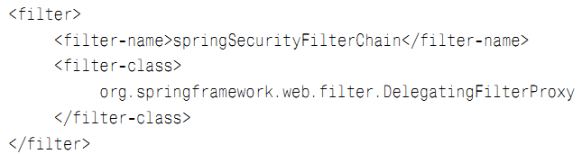
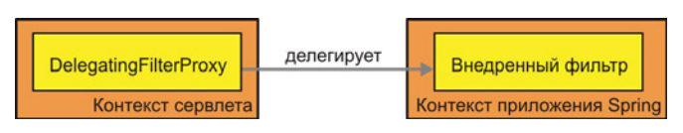
Spring Security servlet-filtering config

Slide 5
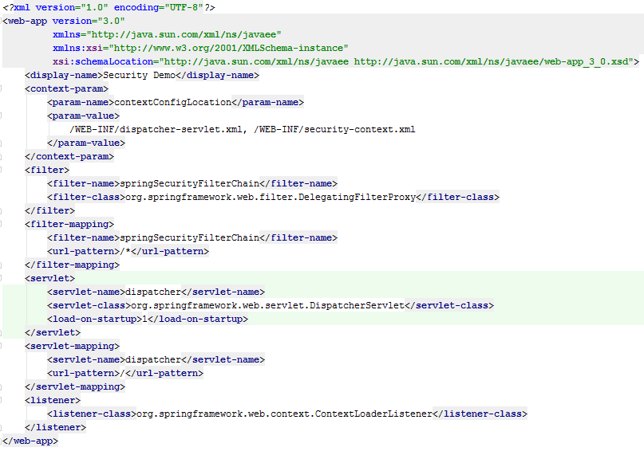
Spring Security servlet-filtering config

Slide 6
Spring Security xml
<beans xmlns="http://www.springframework.org/schema/beans" xmlns:security="http://www.springframework.org/schema/security" xmlns:xsi="http://www.w3.org/2001/XMLSchema-instance" xsi:schemaLocation="http://www.springframework.org/schema/beans http://www.springframework.org/schema/beans/spring-beans-3.0.xsd http://www.springframework.org/schema/security http://www.springframework.org/schema/security/spring-security-3.0.xsd"> <!-- Здесь располагаются элементы с префиксом security: --> <security:http auto-config="true"/> </beans>
<beans:beans xmlns="http://www.springframework.org/schema/security" xmlns:beans="http://www.springframework.org/schema/beans" xmlns:xsi="http://www.w3.org/2001/XMLSchema-instance" xsi:schemaLocation="http://www.springframework.org/schema/beans http://www.springframework.org/schema/beans/spring-beans-4.1.xsd http://www.springframework.org/schema/security http://www.springframework.org/schema/security/spring-security-4.0.xsd"> <!-- Здесь располагаются элементы без префикса security: --> <http auto-config="true"/> </beans:beans>

Slide 7
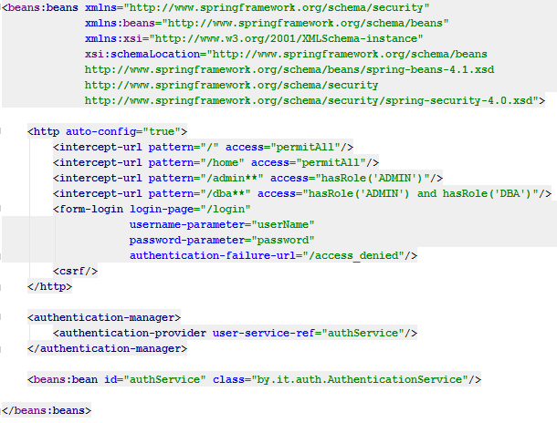
Spring Security web-security.xml

Slide 8
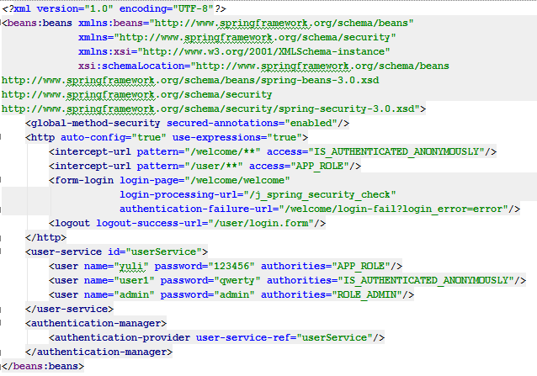
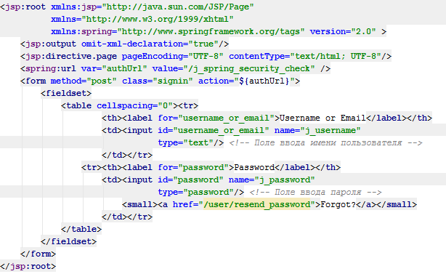
Spring Security form configuration

Slide 9
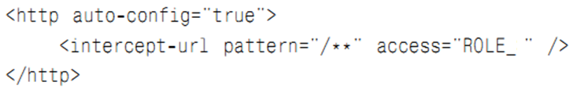
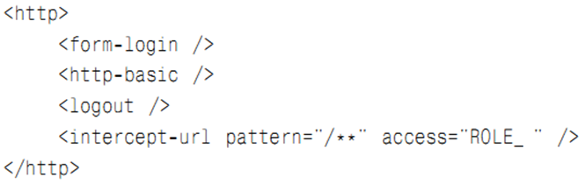
Spring Security simple configuration

Slide 10
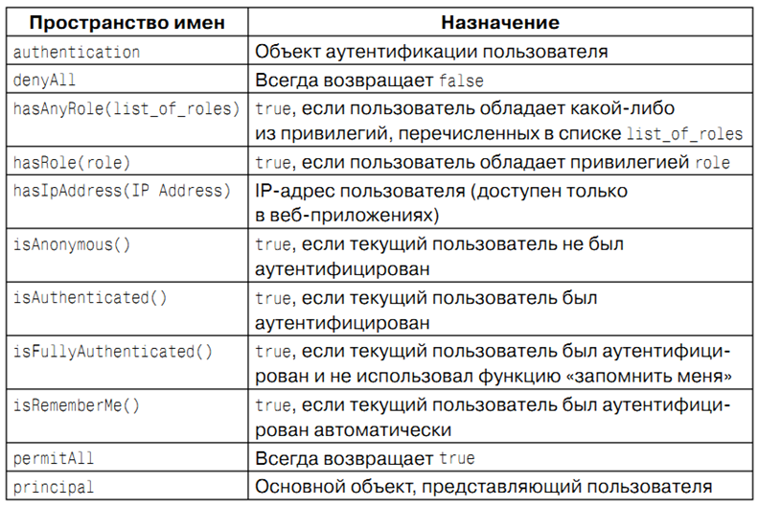
Spring Security expressions

Slide 11

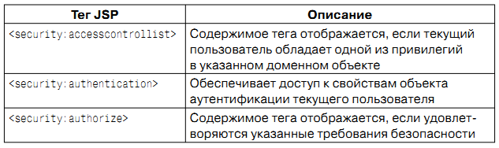
Spring Security tags for View
<?xml version="1.0" encoding="UTF-8"?> <html xmlns:jsp="http://java.sun.com/JSP/Page" xmlns:c="http://java.sun.com/jsp/jstl/core" xmlns:sec="http://www.springframework.org/security/tags" xmlns:spring="http://www.springframework.org/tags" version="2.0">

Slide 12
Spring Security tags for View
<?xml version="1.0" encoding="UTF-8"?> <html xmlns:jsp="http://java.sun.com/JSP/Page" xmlns:c="http://java.sun.com/jsp/jstl/core" xmlns:sec="http://www.springframework.org/security/tags" xmlns:spring="http://www.springframework.org/tags" version="2.0"> <jsp:directive.page pageEncoding="UTF-8" contentType="text/html; UTF-8"/> <head> <title>Admin page</title> </head> <body> <sec:authorize access="hasRole('ROLE_ADMIN')"> <span><spring:message code="user.info.welcome.email"/><jsp:text> </jsp:text><sec:authentication property="principal.displayName"/> </span> </sec:authorize> <sec:accesscontrollist/> Dear <strong>${user}</strong>, Welcome to Admin Page. <c:url var="logout" value="/logout"/> <a href="${logout}">Logout</a> </body> </html>

Slide 13
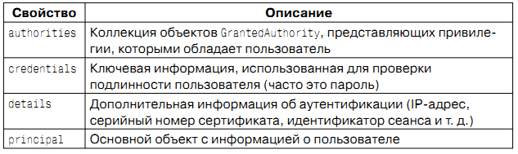
Spring Security <security:authentication>

Slide 14
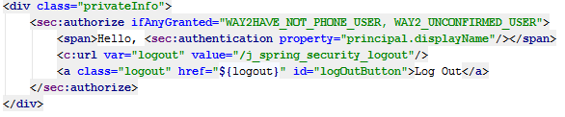
Spring Security logout

Slide 15
Spring Security expressions example
<sec:intercept-url pattern="/user/phone-update.form"
access="hasAnyRole('WAY2HAVE_NOT_PHONE_USER', 'WAY2_UNCONFIRMED_USER')"/>

Slide 16
Spring Security Repository access config

Slide 17
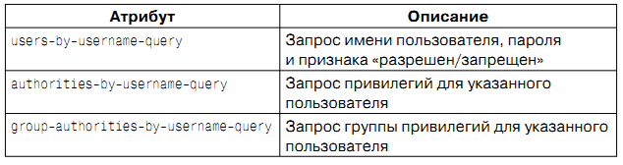
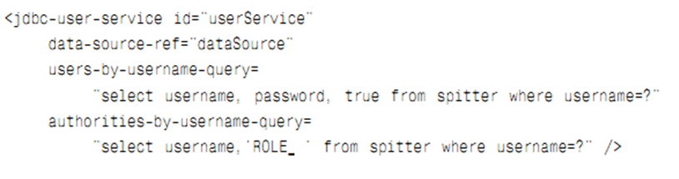
Spring Security jdbc access config

Slide 18
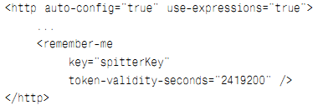

Spring Security <remember-me>

Slide 19
Spring Security Annotations
 с помощью аннотации @Secured;
 с помощью аннотации JSR-250: @RolesAllowed ;
 с помощью аннотаций Spring, проверяющих условия до и после вызова метода;
 посредством сопоставления метода с одним или более множествами точек внедрения

Slide 20
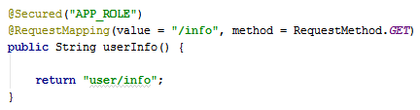
Spring Security Annotations. @Secured

Slide 21
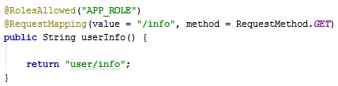
Spring Security JSR-250 @RolesAllowed

Slide 22
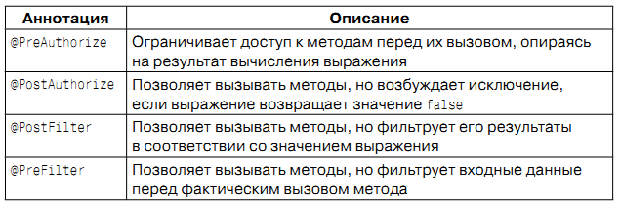
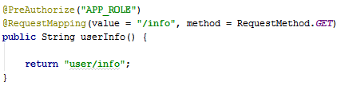
Spring Security. Pre-post-annotations

Slide 23
Ваши вопросы?

Slide 24
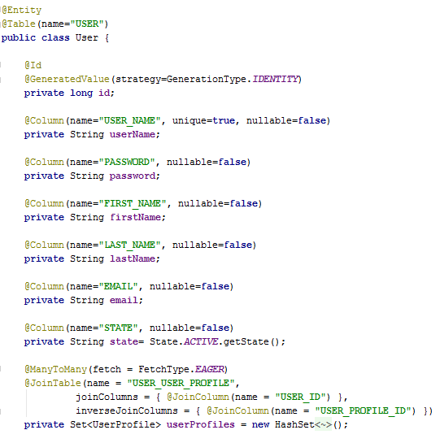
Spring Security. Xml configuration

Slide 25
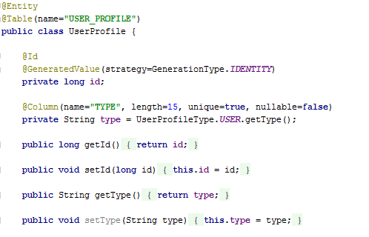
Spring Security. Xml configuration

Slide 26
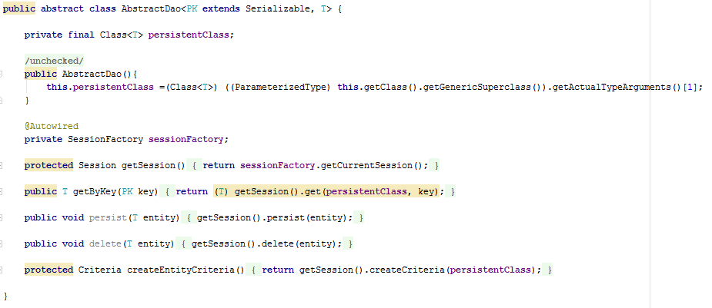
Spring Security. Xml configuration

Slide 27
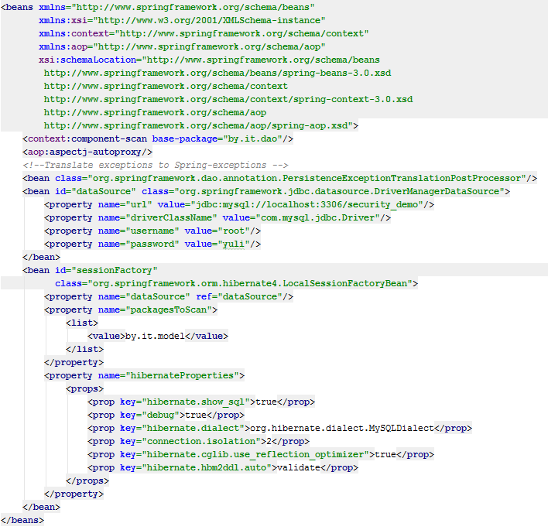
Spring Security. Xml configuration

Slide 28
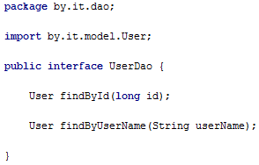
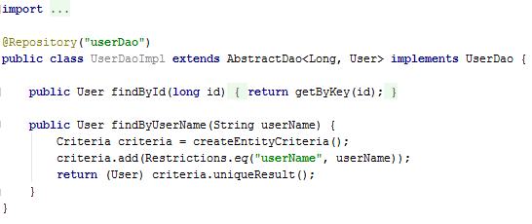
Spring Security. Xml configuration

Slide 29
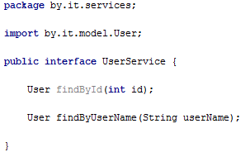
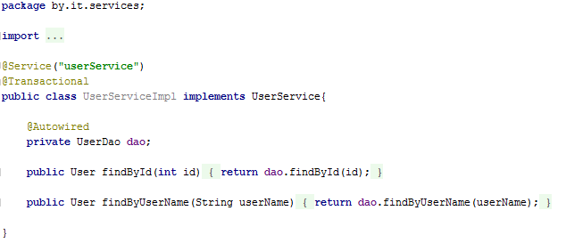
Spring Security. Xml configuration

Slide 30
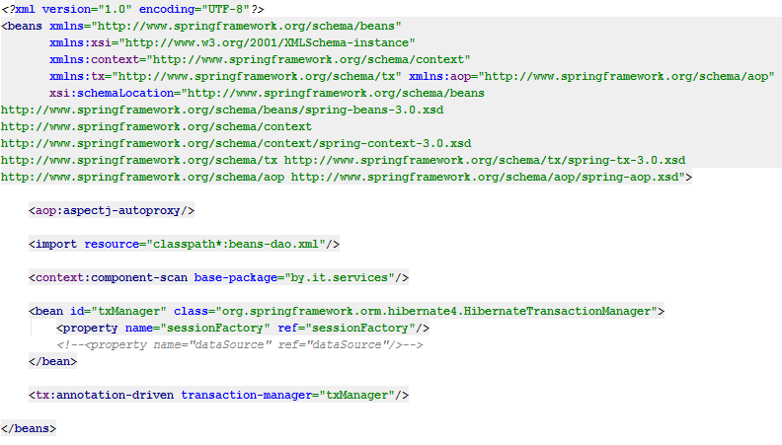
Spring Security. Xml configuration

Slide 31
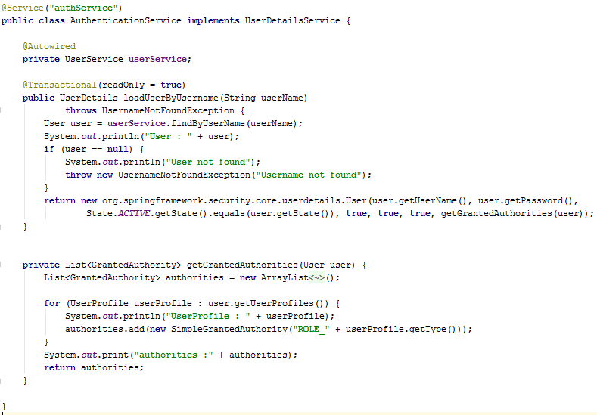
Spring Security. Xml configuration

Slide 32
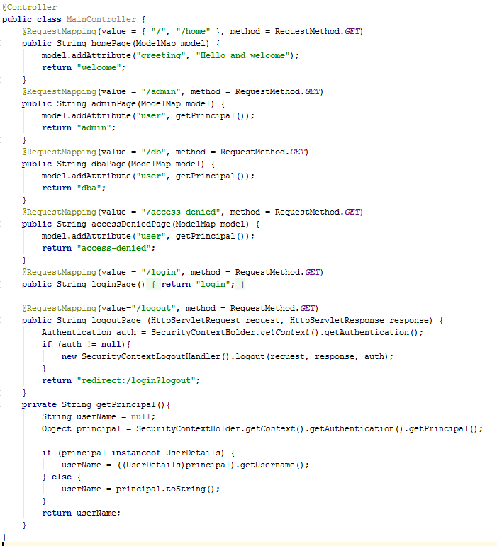
Spring Security. Xml configuration

Slide 33
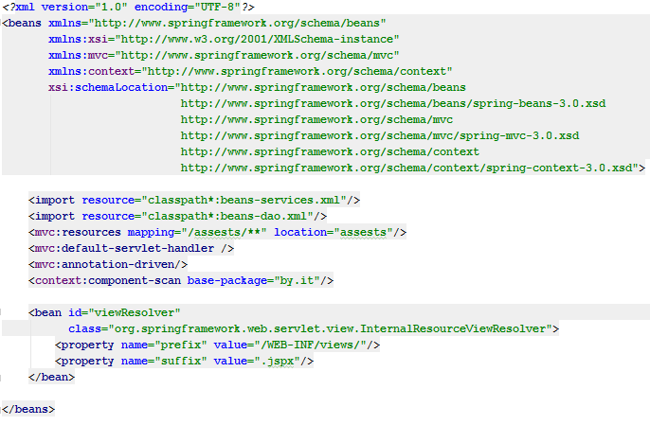
Spring Security. Xml configuration

Slide 34
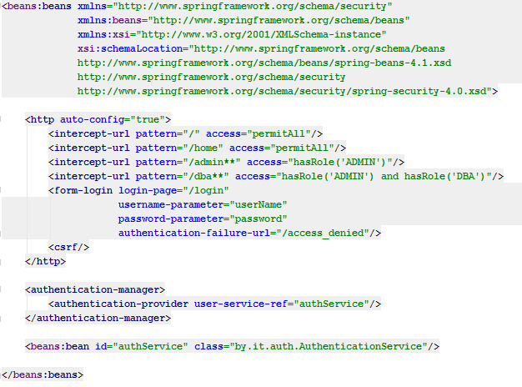
Spring Security. Xml configuration

Slide 35
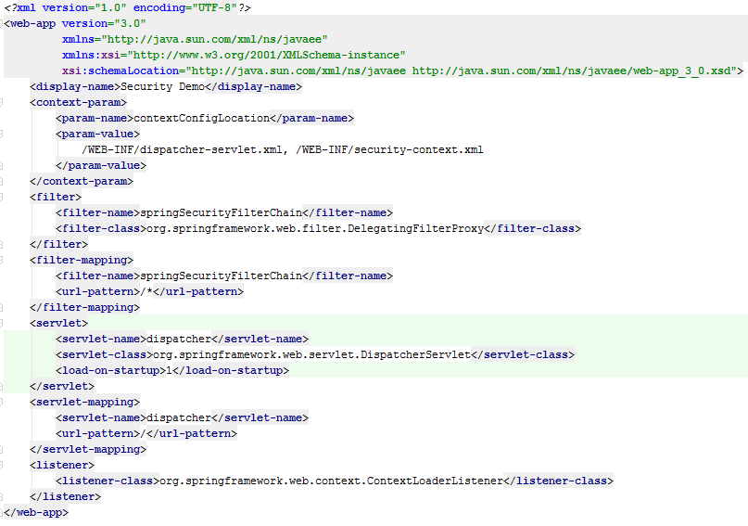
Spring Security. Xml configuration

Slide 36
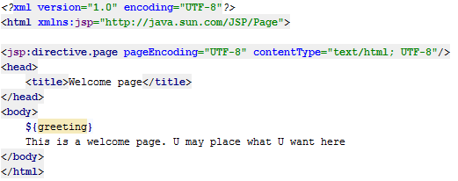
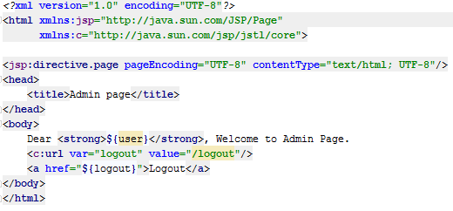
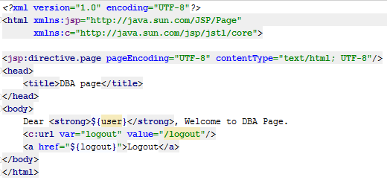
Spring Security. Xml configuration

Slide 37
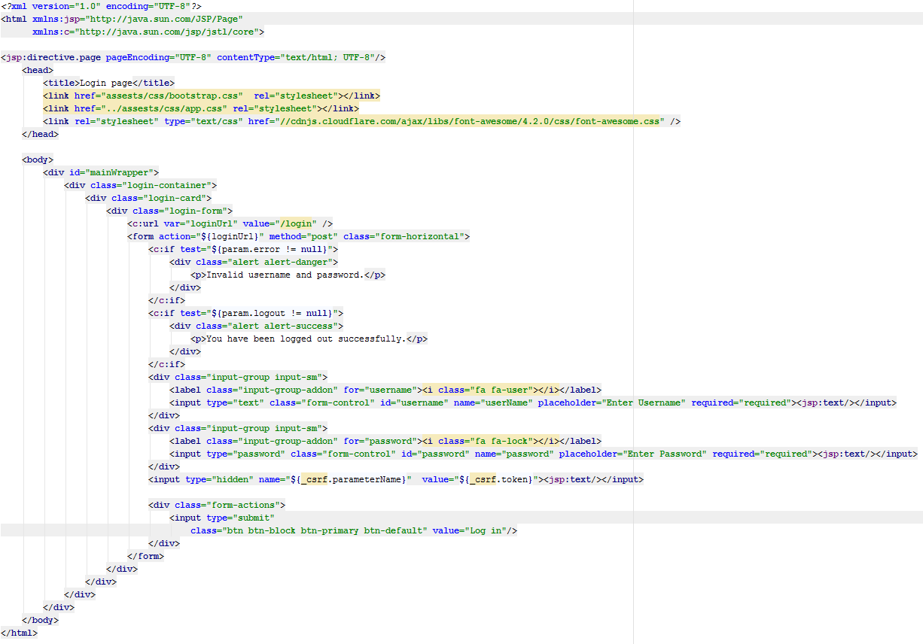
Spring Security. Xml configuration

Slide 38
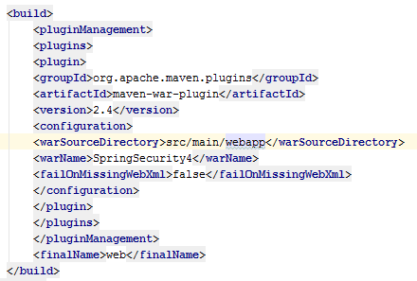
Spring Security. Annotation configuration

Slide 39
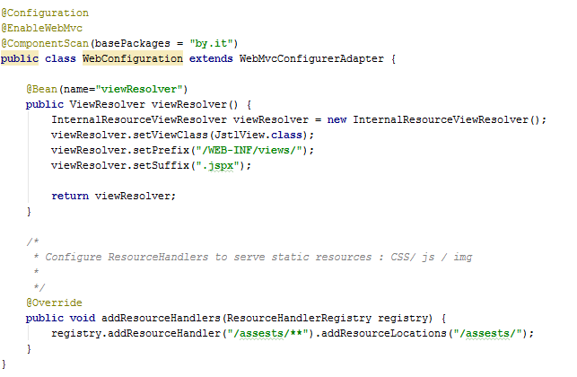
Spring Security. Annotation configuration

Slide 40
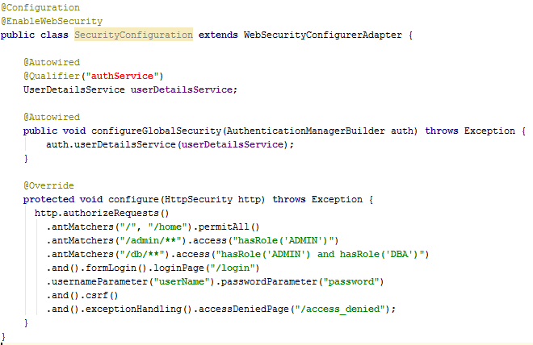
Spring Security. Annotation configuration

Slide 41
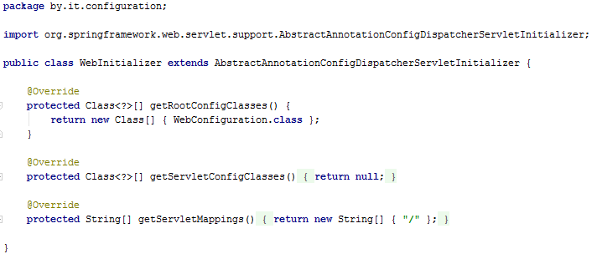
Spring Security. Annotation configuration

Slide 42
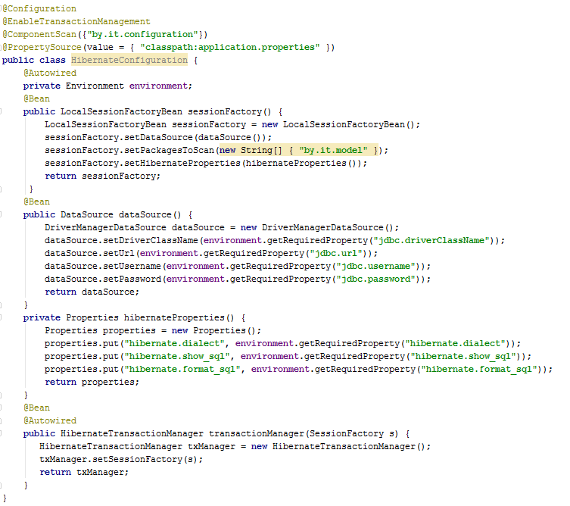
Spring Security. Annotation configuration

Slide 43
Практика
Реализуйте Spring MVC проект. Настройте Spring Security.

